Slide 1

Relationship Between Median Age and Death Rate (2021)
Course: 7COM1079 – Team Research & Development
Tools Used: RStudio, GitHub, ggplot2

Slide 2

Introduction
Purpose: investigate global demographic indicators
Dataset: "all_indicators.csv" provided by module
Focus variables:
Median Age in 2021
Death Rate in 2021
Research Type: Correlation analysis
Why important: ageing population impacts health & mortality

Slide 3
Research Question
RQ:
Is there a statistically significant correlation between a country’s Median Age (2021) and Death Rate (2021)?
Hypotheses:
H0: There is no correlation between median age and death rate.
H1: There is a correlation between median age and death rate.

Slide 4

Dataset Description
Global dataset containing indicators for ~220 countries
Key variables used:
Med_Age.YR2021
Death.YR2021
Cleaning steps:
Removed missing values
Selected only required columns
Sample size after cleaning: 222 observations

Slide 5
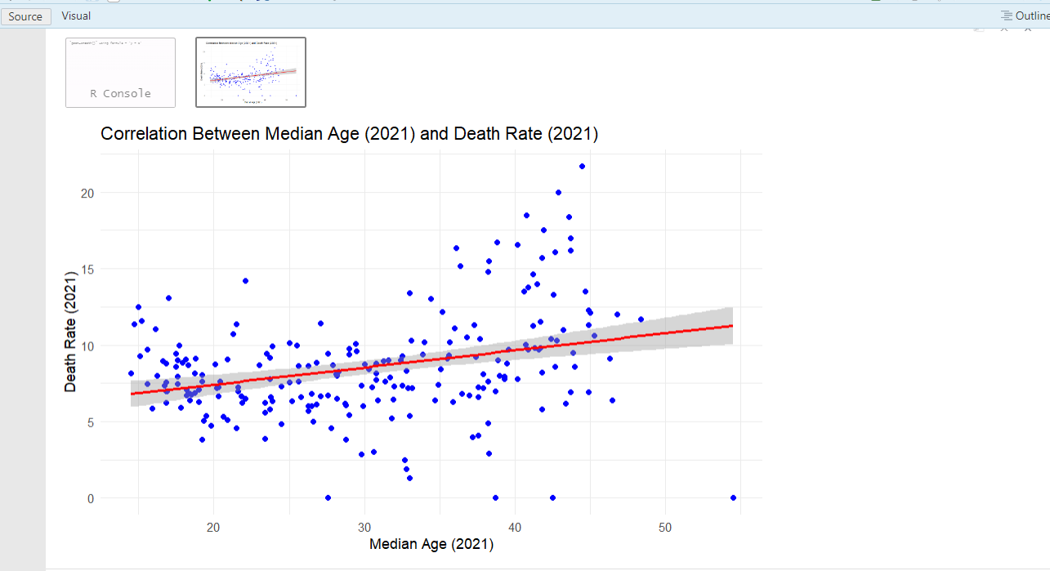
Data Visualization (Scatter Plot)
Scatter plot shows increasing trend
Positive correlation observed visually
Regression line indicates upward slope
Outliers minimal
Visualization suggests older median age = higher death rate

Slide 6
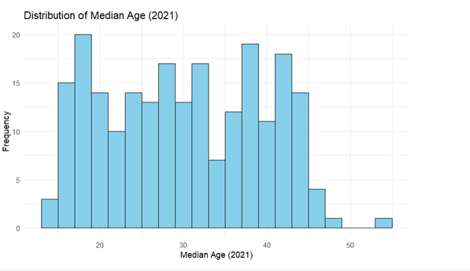
Data Visualization (Histogram)
Histogram of Median Age (2021):
Distribution is slightly right-skewed
Many countries have median age between 25–40
Few countries have ages above 45
Shows demographic diversity across regions

Slide 7
Statistical Analysis
Pearson Correlation Test (R output):
Correlation coefficient (r = 0.303)
p-value = 3.94e-06
95% CI: 0.1719 – 0.4180
Interpretation:
Weak-to-moderate positive correlation
Statistically significant (p < 0.05)
Reject the null hypothesis (H0)

Slide 8

Regression Model Summary
From lm() output:
Slope coefficient: 0.11214
Meaning: for every +1 increase in median age → death rate increases by 0.11 units
R² = 0.090 → 9% of variation explained
Interpretation:
  Median age matters
  But other factors also influence death rate

Slide 9
Group Contribution
Each group member’s contribution:
Vinitha: Data cleaning, CSV preparation, variable selection
Navyasree : R coding, correlation test, regression model
Vivek: Visualizations (scatter plot + histogram)
RanjithReddy: Report writing (intro, background, interpretation)
Student 5: GitHub upload, R Markdown formatting, PPT preparation

Slide 10
Conclusion
Median age and death rate show a significant positive correlation
Older populations experience higher mortality
Correlation is moderate → more variables should be explored
Future work:
Include life expectancy, healthcare quality, fertility rates
Compare trends across multiple years
Study limitations: single-year data, linear model only

Slide 11

THANKYOU

